Slide 1
Exchange Rates
4.5
Copyright Bananaomics

Slide 2
Do you have any experience using an exchange rate? What does it mean to say one currency is stronger than another?
Copyright Bananaomics

Slide 3
Imagine you are on vacation sitting on a nice beach in a tropical country. You've been eating and drinking by the water all day. Here comes the bill, how do you pay?
Copyright Bananaomics

Slide 4
Definition
Exchange Rate
The value of one currency expressed in terms of another currency.
Copyright Bananaomics

Slide 5
Definition
Foreign Exchange Market (FOREX)
Marketplace for exchanging currencies around the globe.
Copyright Bananaomics

Slide 6
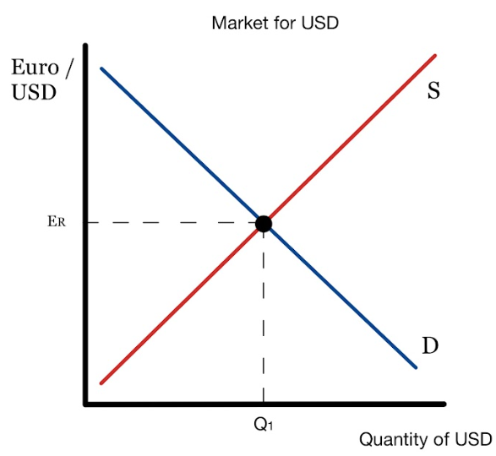
Exchange Rate
Example
Copyright Bananaomics

Slide 7
Floating Exchange Rates
Copyright Bananaomics

Slide 8
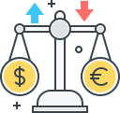
Floating Exchange Rate
An exchange rate system where the exchange rate is determined solely by the market demand and market supply of the currency in the foreign exchange market without any central bank intervention.
Copyright Bananaomics

Slide 9
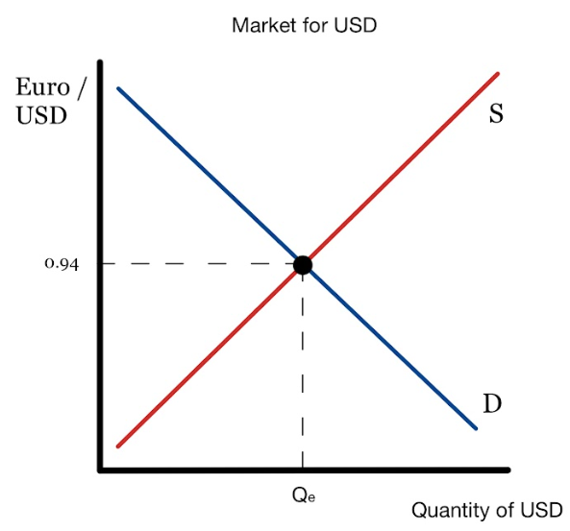
Floating Exchange Rate
Copyright Bananaomics

Slide 10
Changes in Supply/Demand of Currency
Copyright Bananaomics

Slide 11
Causes of Change in Demand of Currency
Example: USA
Foreign demand for US exports
People who desire to invest in the US (FDI & Interest Rates)
Tourists visiting the US
Speculation in the FOREX market
Central bank intervention
Copyright Bananaomics

Slide 12
Causes of Change in Supply of Currency
Example: USA
Domestic demand for foreign imports
People who desire to invest outside the US (FDI & Interest Rates)
US Tourists visiting Thailand
Speculation in the FOREX market
Central bank intervention
Copyright Bananaomics

Slide 13
Complete List of Influences
Foreign demand for exports
Domestic demand for imports
Inward/outward foreign direct investment (FDI)
Inward/outward portfolio investment
Remittances
Speculation
Relative inflation rates
Relative interest rates
Relative growth rates
Central bank intervention
Copyright Bananaomics

Slide 14
Appreciation & Depreciation
In a floating exchange rate system . . .
Appreciation
When the price of a currency increases in a floating exchange rate system.
Depreciation
A decrease in the value of a currency in terms of another currency in a floating or managed exchange rate system.
Copyright Bananaomics

Slide 15
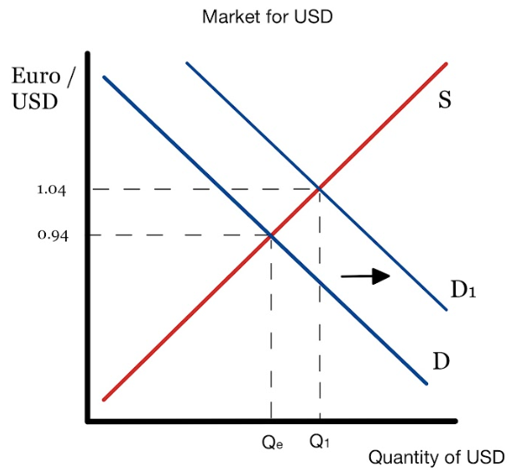
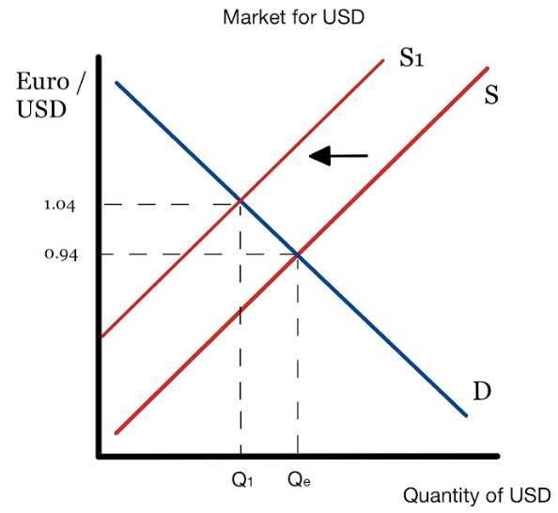
Appreciation
Copyright Bananaomics

Slide 16
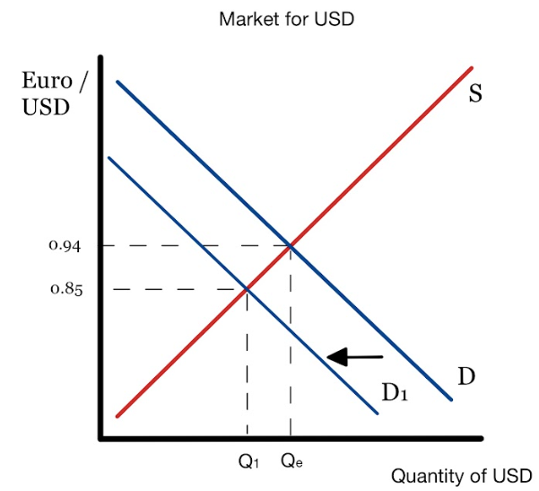
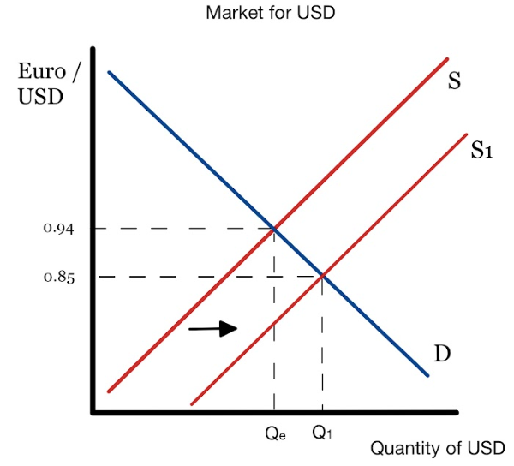
Depreciation
Copyright Bananaomics

Slide 17
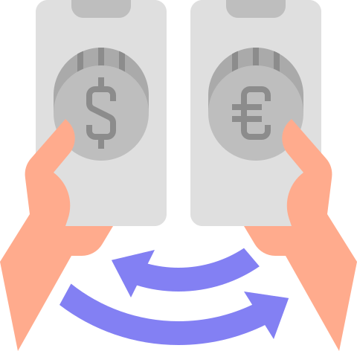
Most Important
When one country DEMANDS more of a currency, they must SUPPLY their own in the Forex market.
Copyright Bananaomics

Slide 18
Example
Draw a USD Exchange Rate diagram comparing USD and Euro. Draw the impact of European citizens visiting the USA on vacation.
Copyright Bananaomics

Slide 19
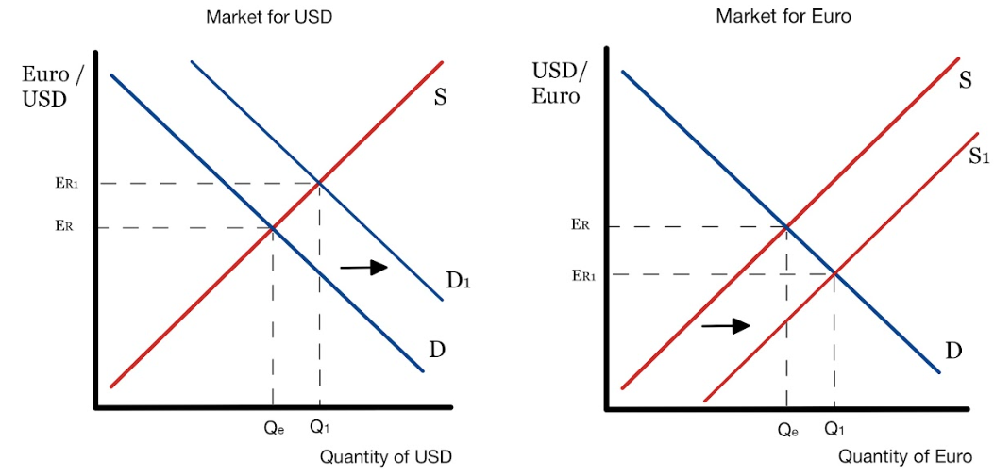
Example
Draw a USD Exchange Rate diagram comparing USD and Euro. Draw the impact of European citizens visiting the USA on vacation.
Copyright Bananaomics

Slide 20
Example
Draw an exchange rate diagram for British Pounds and Mexican Pesos. Draw the effect of cheaper Mexican goods for export.
Copyright Bananaomics

Slide 21
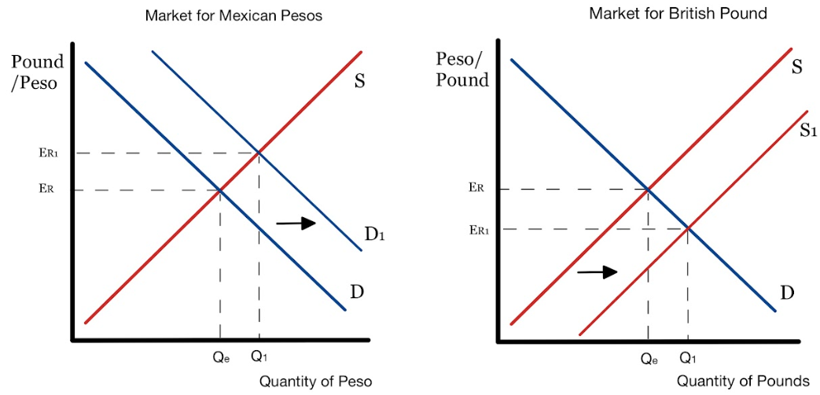
Example
Draw an exchange rate diagram for British Pounds and Mexican Pesos. Draw the effect of cheaper Mexican goods for export.
Copyright Bananaomics

Slide 22
Example
Draw an Exchange Rate diagram comparing the Japanese Yen and Thai Baht. Draw the impact of an increase in Japanese interest rates.
Copyright Bananaomics

Slide 23
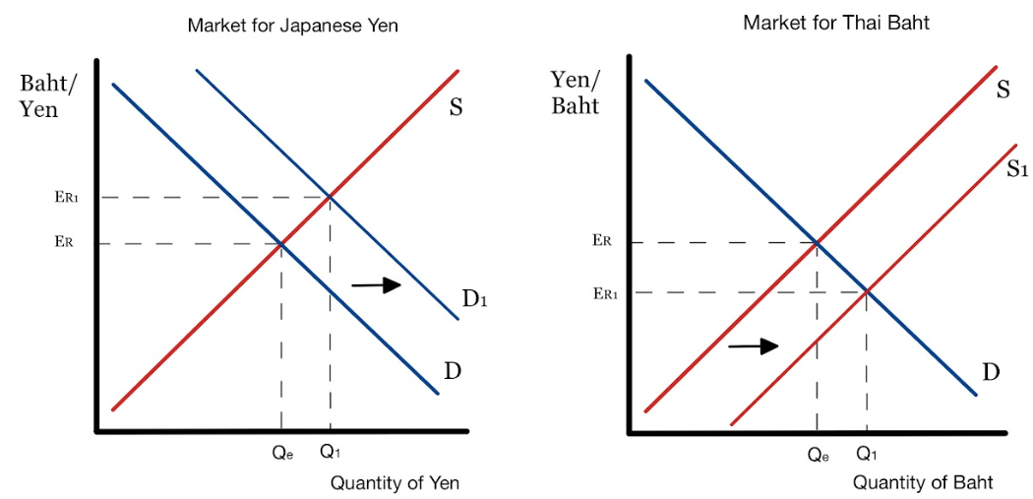
Example
Draw an Exchange Rate diagram comparing the Japanese Yen and Thai Baht. Draw the impact of an increase in Japanese interest rates.
Copyright Bananaomics

Slide 24
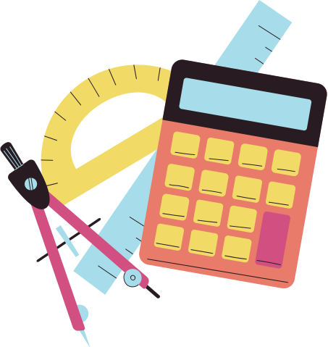
Calculating the Price of a Good in Different Currencies
Copyright Bananaomics

Slide 25
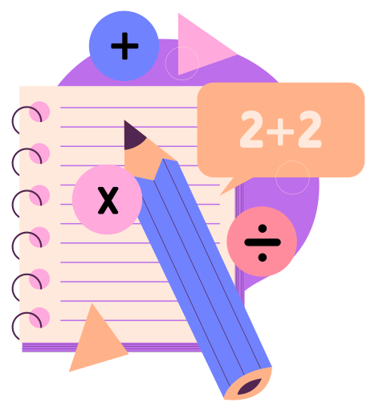
Calculations
Assume the exchange rate of the Euro and Indian Rupee is 1 Euro = 83 Rupee
How much does a 3 Euro sandwich cost in Rupees?
How much does a 28 Euro car wash cost in Rupees?
How much is a 1400 Rupee taxi ride cost in Euros?
How much is a 800 Rupee museum ticket cost in Euros?
Copyright Bananaomics

Slide 26
Calculations
Assume the exchange rate of the Euro and Indian Rupee is 1 Euro = 83 Rupee
How much does a 3 Euro sandwich cost in Rupees? 249 Rupees
How much does a 28 Euro car wash cost in Rupees? 2324 Rupees
How much is a 1400 Rupee taxi ride cost in Euros? 16.87 Euros
How much is an 800 Rupee museum ticket cost in Euros? 9.64 Euros
Copyright Bananaomics

Slide 27
Consequences of Change in Exchange Rate
Copyright Bananaomics

Slide 28
Consequences of Change in Exchange Rate
The inflation rate
An increase in inflation leads to higher costs of resources or deflation could make goods cheaper.
Economic growth
Changes in exchange rate impact imports/exports.
Unemployment
As currencies appreciate, exports become less desirable and therefore potential increase in unemployment.
The current account balance
Outflow/Inflow of money affects imports/exports
Living standards
Countries overly reliant on tourism or trade can experience significant impacts on standards of living.
Copyright Bananaomics

Slide 29
Fixed Exchange Rates
Copyright Bananaomics

Slide 30
Fixed Exchange Rate
An exchange rate system where the exchange rate is fixed, or pegged, to the value of another currency (or to the average value of a selection of currencies) and maintained there with appropriate central bank intervention.
Copyright Bananaomics

Slide 31
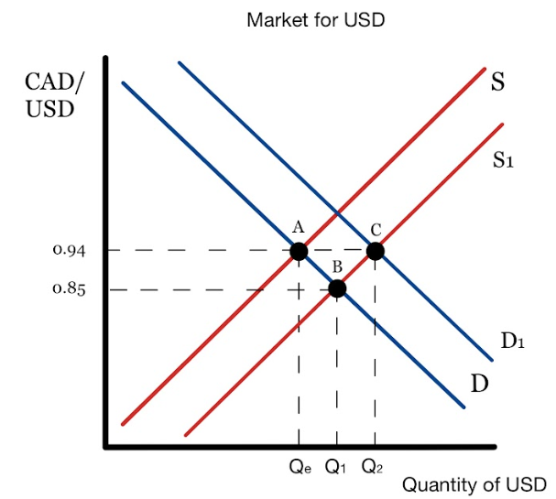
Fixed Exchange Rate
Copyright Bananaomics

Slide 32
Revaluation & Devaluation
In a fixed exchange rate system . . .
Revaluation
An increase in the value of a currency in a fixed exchange rate system.
Devaluation
A decrease in the value of a currency in a fixed exchange rate system.
Copyright Bananaomics

Slide 33
Managed Exchange Rates
Copyright Bananaomics

Slide 34
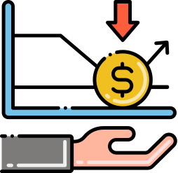
Managed Exchange Rate
An exchange rate that floats in the foreign exchange markets but is subject to intervention from time to time by domestic monetary authorities, in order to prevent undesirable movements in the exchange rate.
Copyright Bananaomics

Slide 35
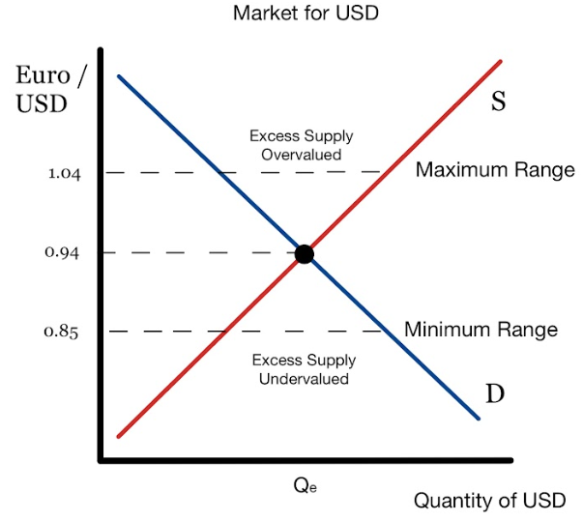
Overvalued and Devalued Currencies
Copyright Bananaomics

Slide 36
Floating and Fixed Exchange Rates- Macroeconomics
Jacob Clifford
Copyright Bananaomics

Slide 37
Fixed Versus Floating Exchange Rate Regimes
(HL only)
Copyright Bananaomics

Slide 38
Pros and Cons
Fixed Exchange Rate Regime
Economic stability
Ease of policy and legislation as the exchange rate doesn't change
Difficult and time consuming to adjust
Requirement of currency reserves to reset the exchange rate
Copyright Bananaomics

Slide 39
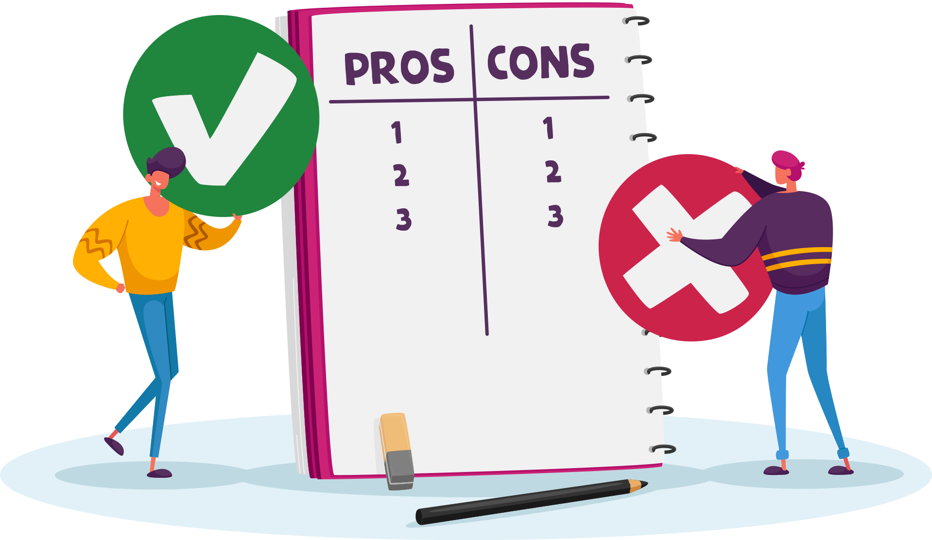
Pros and Cons
Floating Exchange Rate Regime
Easily adjustable (automatic)
No requirement of currency reserves
Susceptible to speculation and large exchange rate swings
Policies and Legislation may be influenced by current exchange rate.
Copyright Bananaomics

Slide 40
Practice Question
Copyright Bananaomics

Slide 41
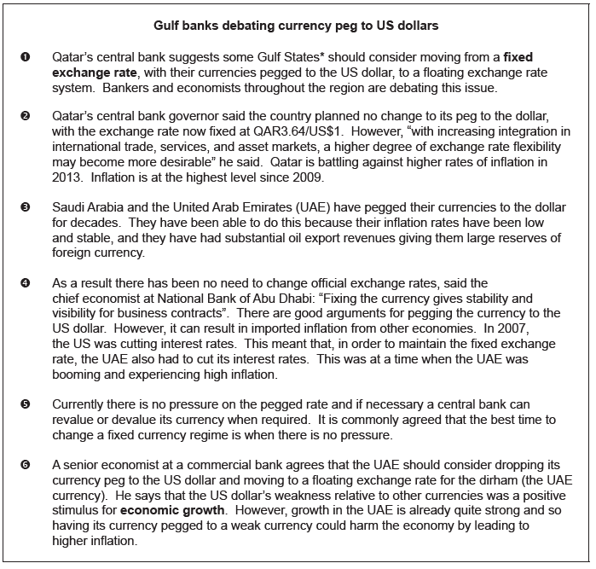
Paper 2
N15/3/ECONO/HP2/ENG/TZ0/XX
Copyright Bananaomics

Slide 42
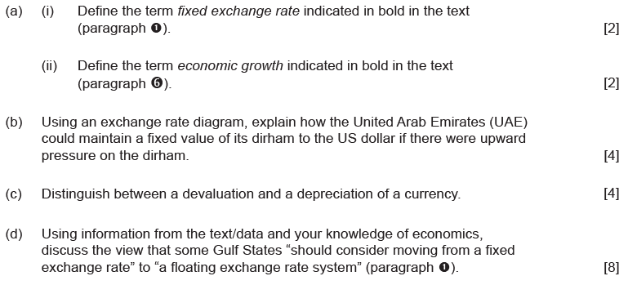
Paper 2
N15/3/ECONO/HP2/ENG/TZ0/XX
Copyright Bananaomics

Slide 43
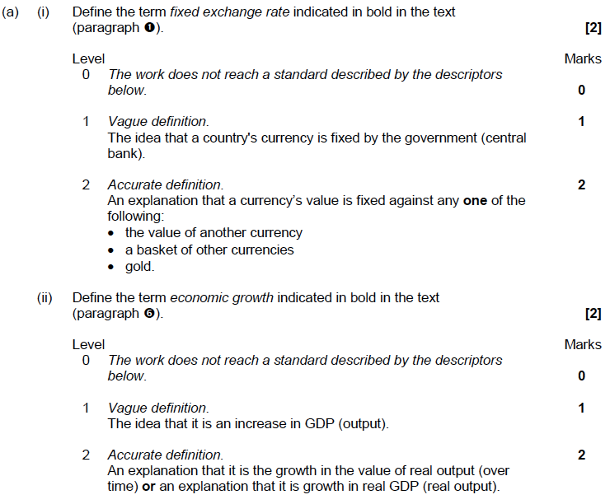
Mark Scheme
Copyright Bananaomics

Slide 44
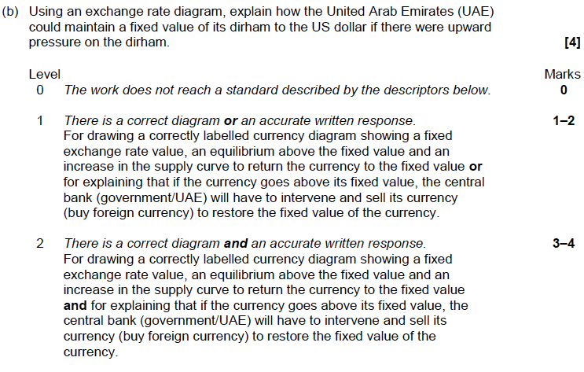
Mark Scheme
Copyright Bananaomics

Slide 45
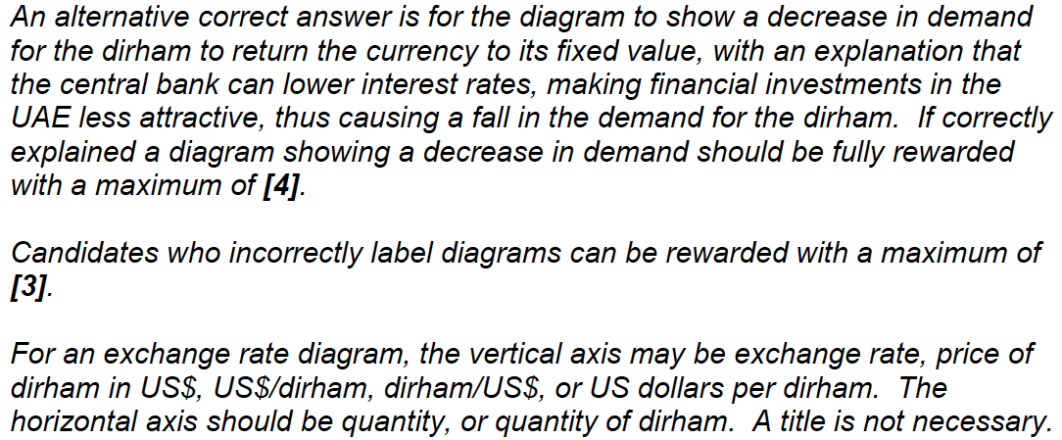
Mark Scheme
Copyright Bananaomics

Slide 46
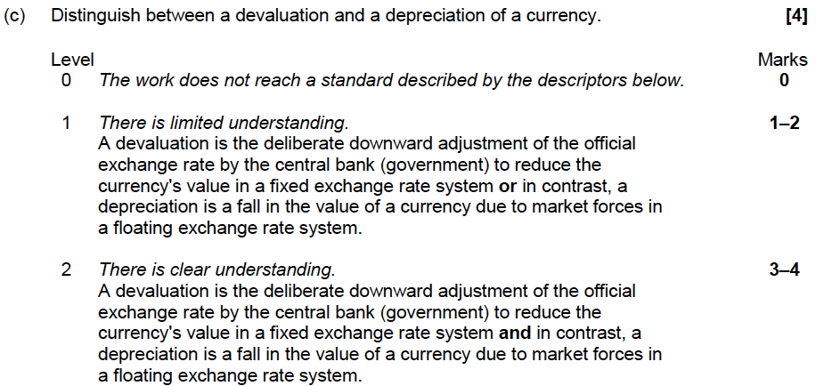
Mark Scheme
Copyright Bananaomics

Slide 47
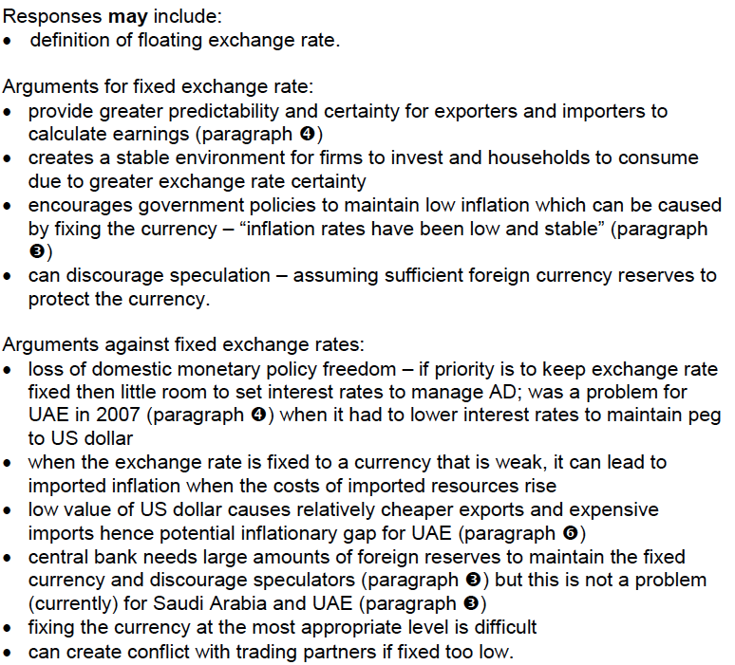
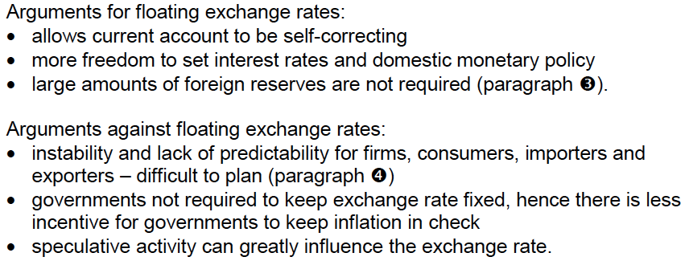
Mark Scheme
Copyright Bananaomics

Slide 48
Enjoying The Content?
Visit bananaomics.com to purchase package deals with discount prices!
BANANAOMICS

